Slide 1
Story Keeper
The Journal of Heroes
Tristan Barajas(Project Manager) Christian Boyd(Lead designer) Tristan Willis(Table-Top RPG specialist)

Slide 2
Problem:
DM is in the middle of a detailed description...
How do you spell that?
Wait, what was that?
Let me look through my notes!
I am sure I wrote this down somewhere.

Slide 3
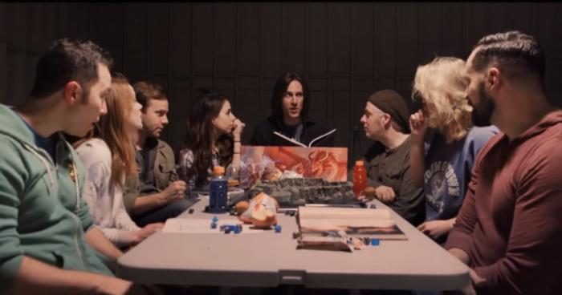
Contextual Inquiries
Mark - A Dungeon Master with a crew of inexperienced players
Players frequently say “Wait, hold on” and stop the game while they finish taking notes
Mark frequently improvises the story, creating sudden info that needs to be recorded quickly

Slide 4
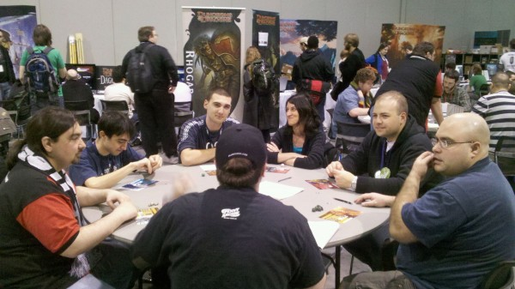
Contextual Inquiries
Jim - An experienced Dungeon Master with 3 experienced players.
Players ask for small bits of information multiple times, which have to be looked up in the book.
Has to search book for NPC or Town information for many different people and places.
John - Dungeons and Dragons player
Player took time after any information he deemed important to write down notes which cause him to have to ask for information repeated.
Had a large amount of notes he needed to condense at session's end.

Slide 5
Our Design Tasks
Store important game information.
Look up specific events, places, people or items.
Sort large volumes of game data.
Look up outside information from official game sources.
Edit outdated information.
Share game information with other players.

Slide 6
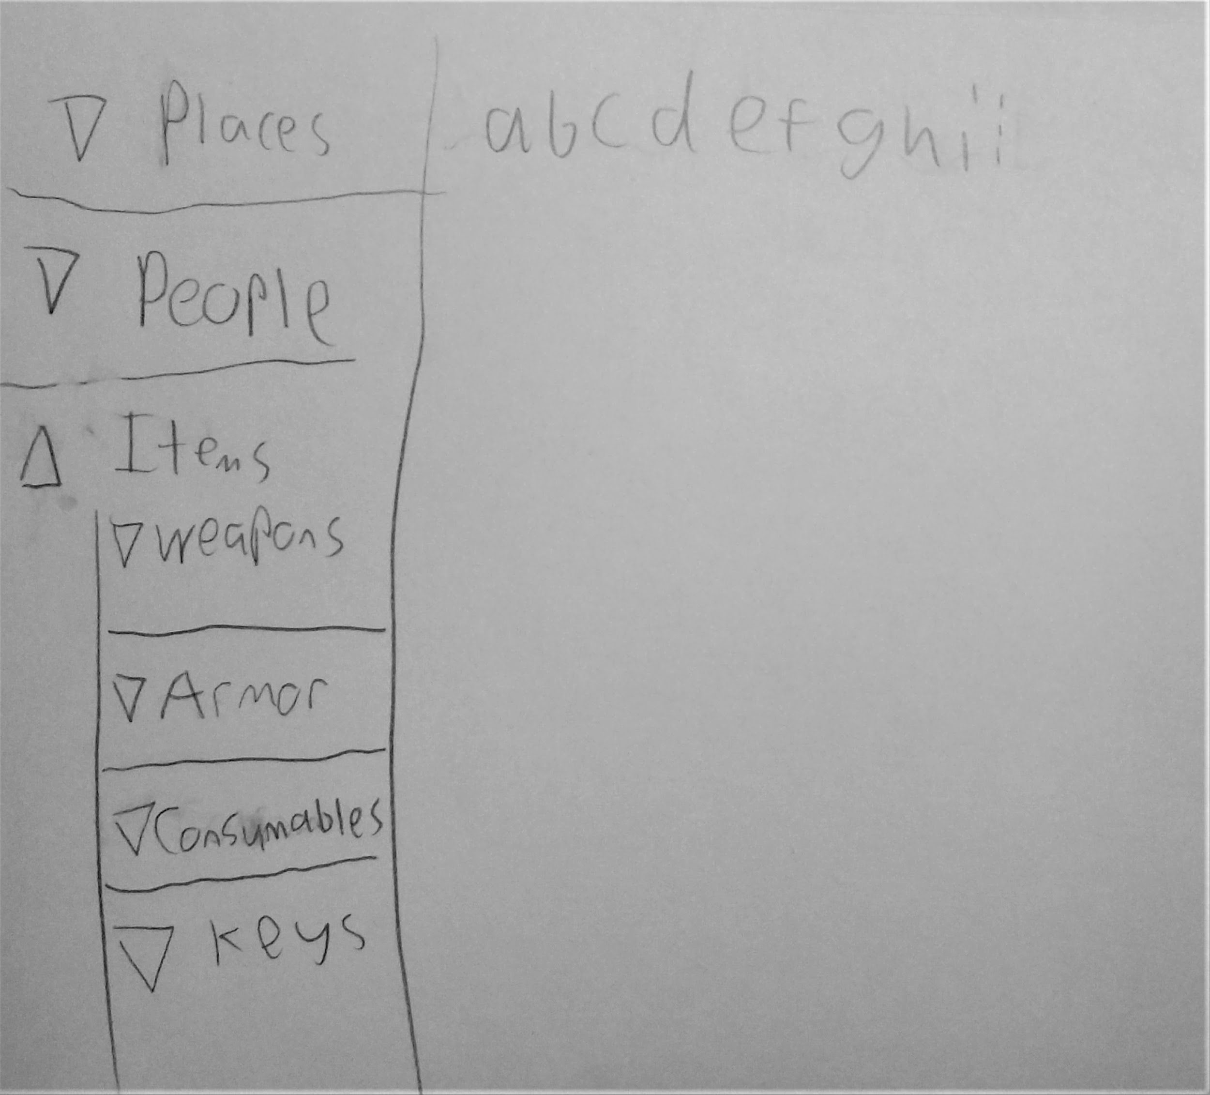
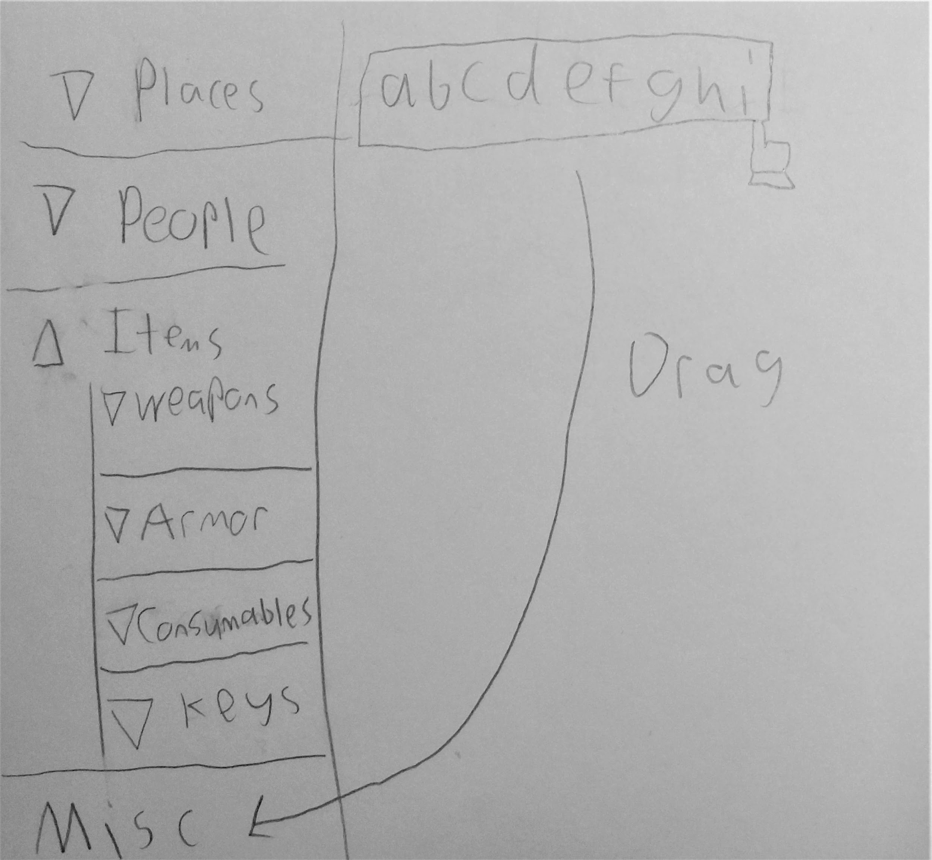
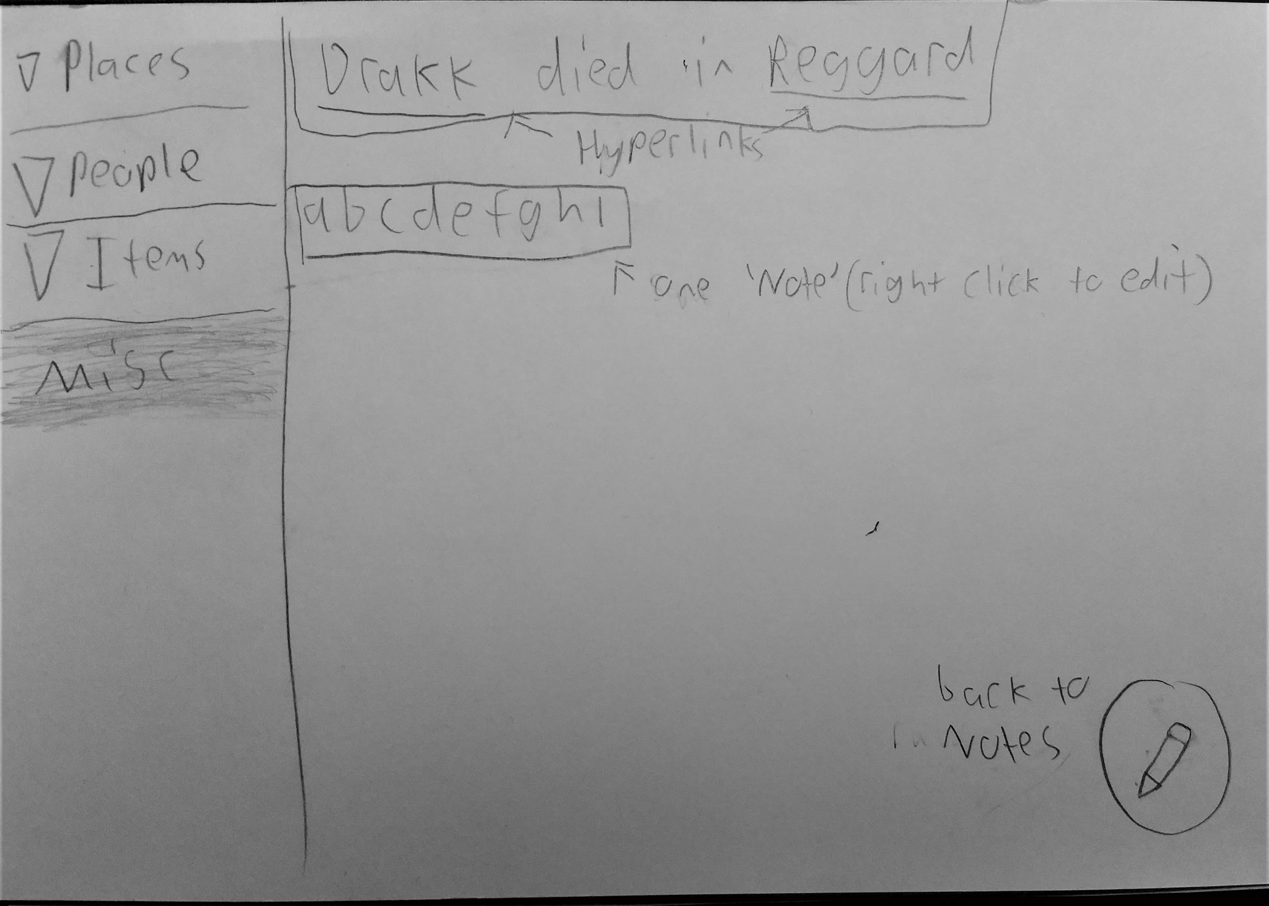
Design Sketches
Design 1 - a desktop ‘wiki’ tool

Slide 7
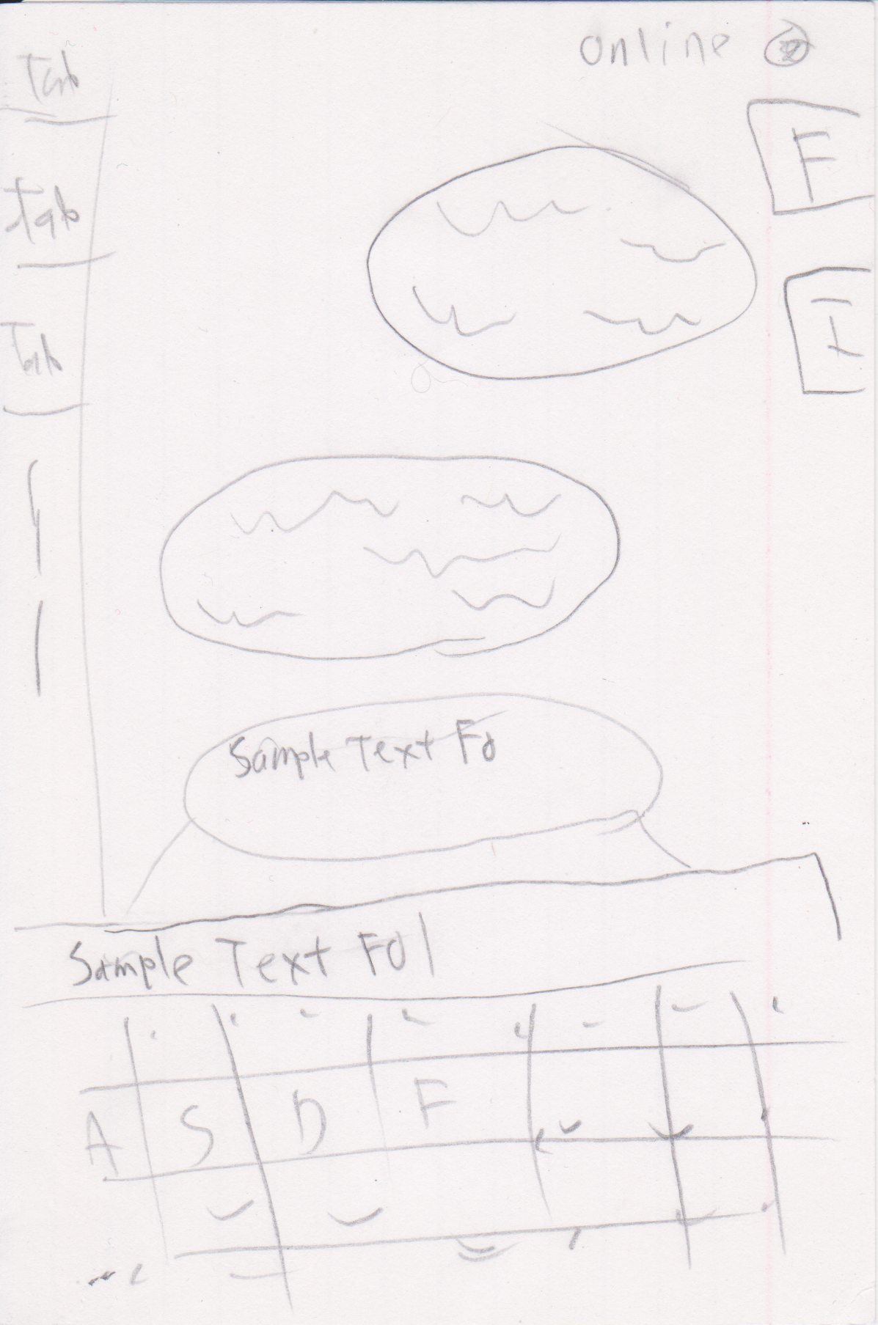
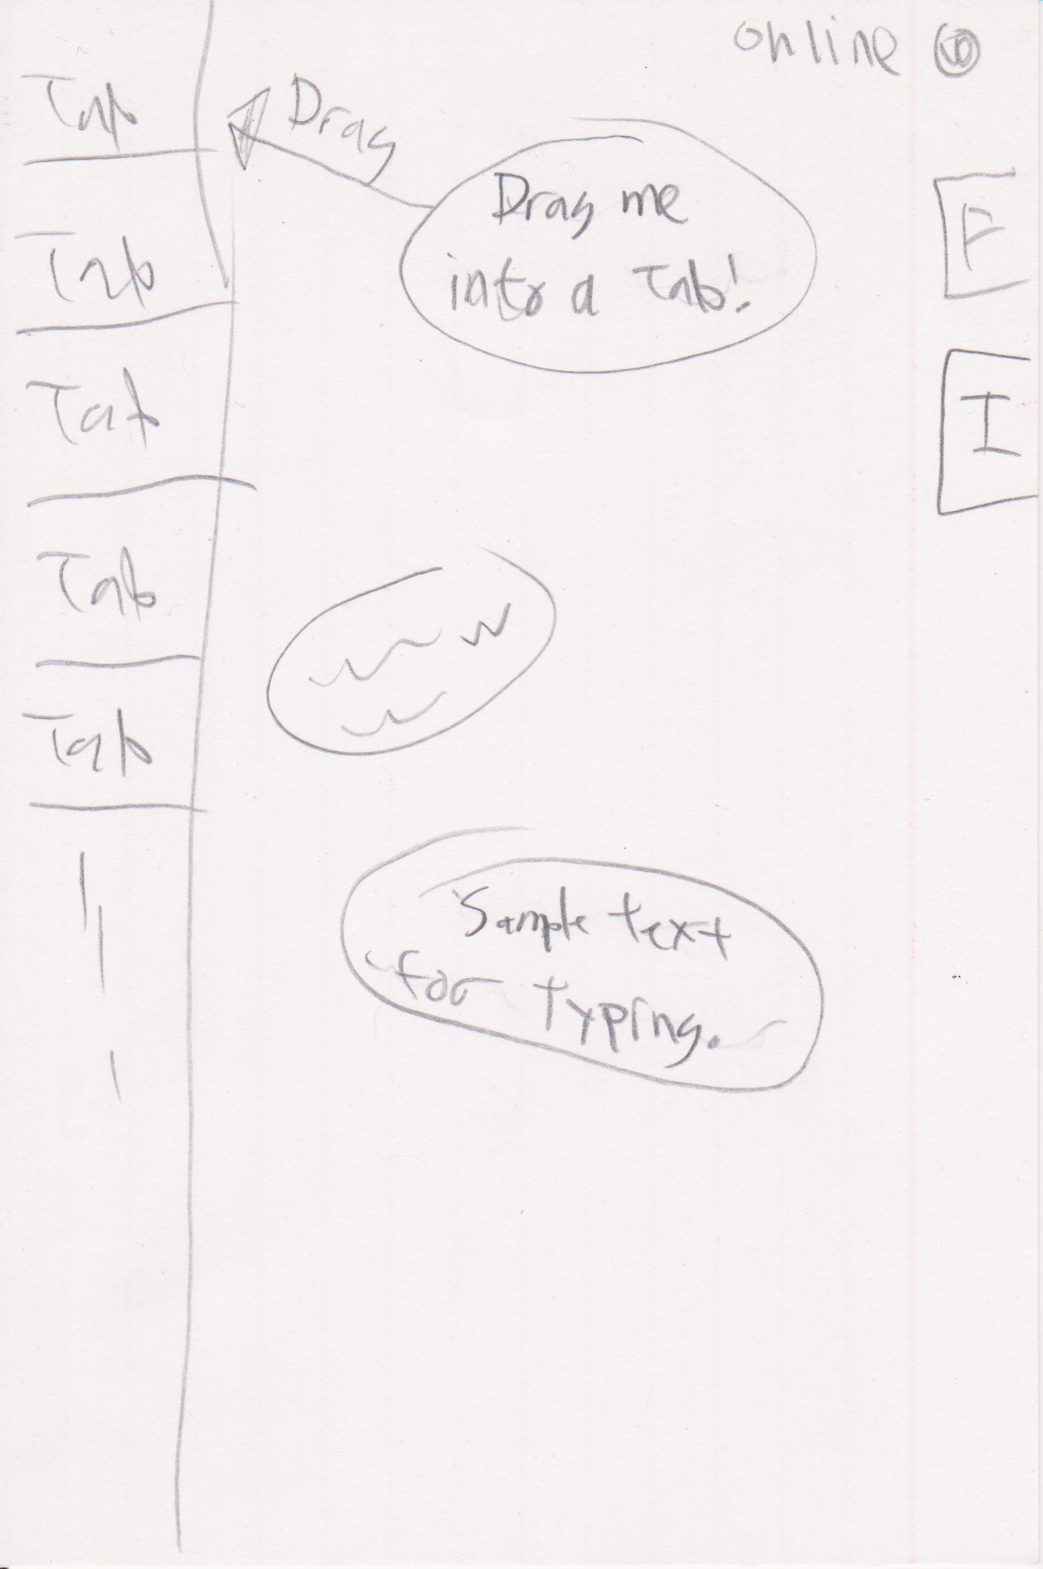
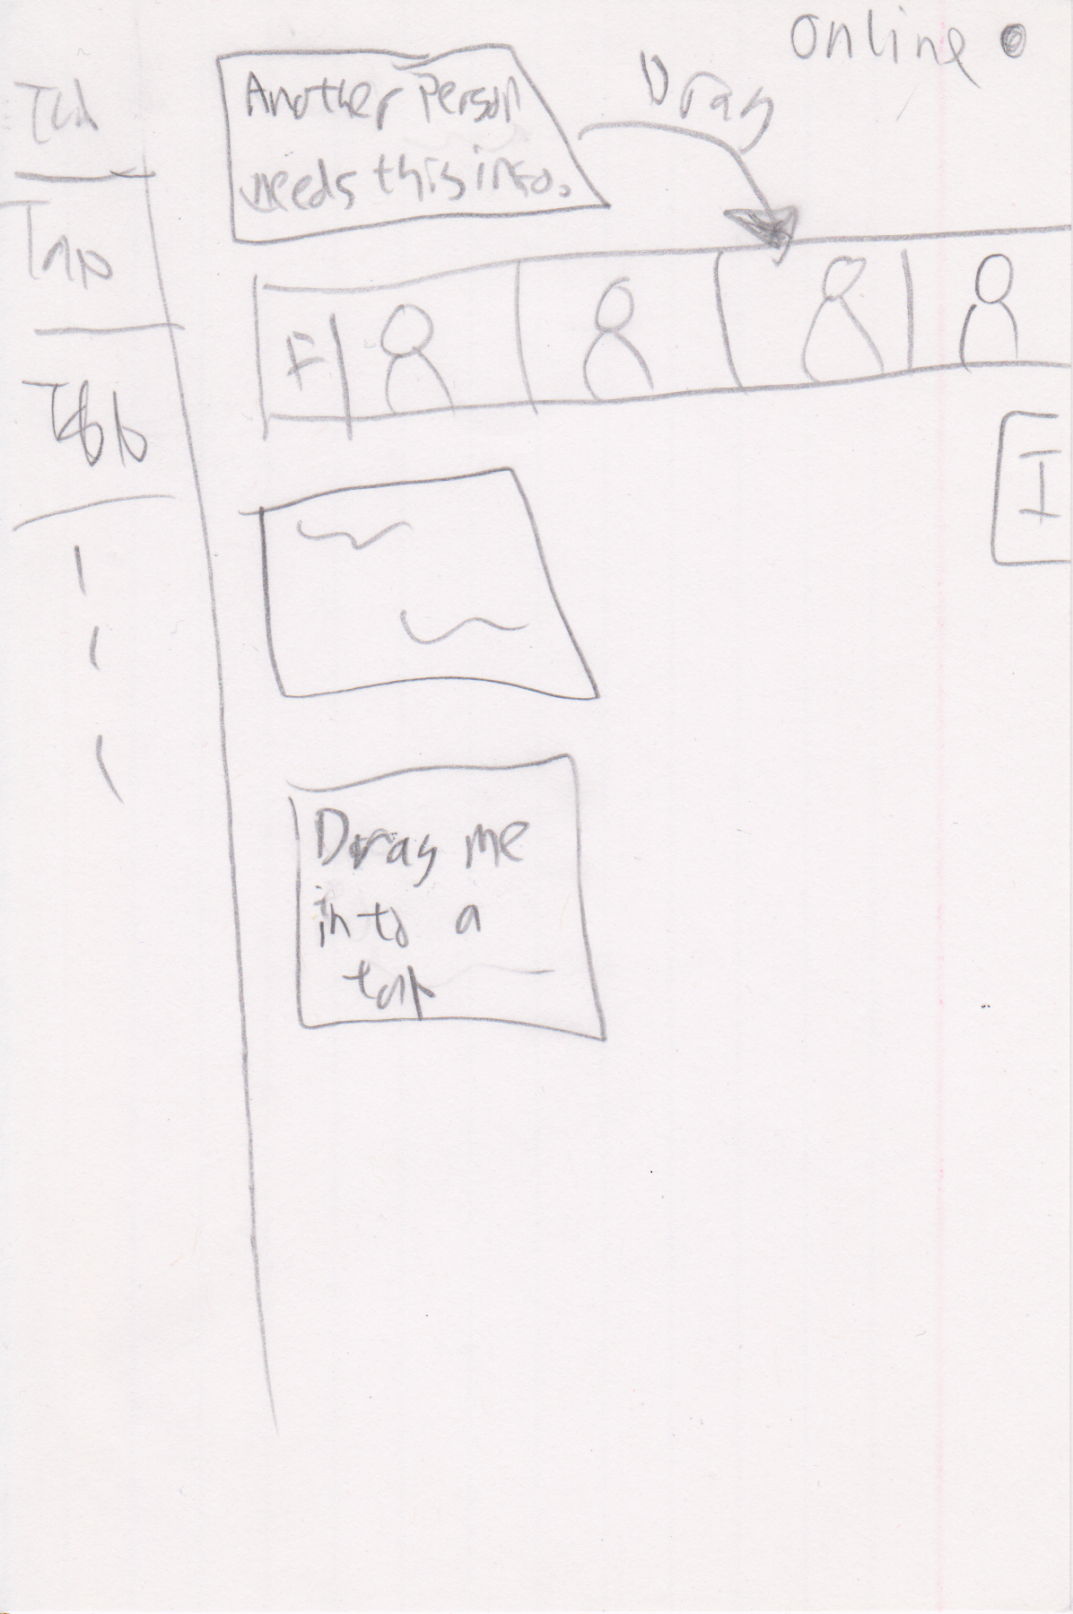
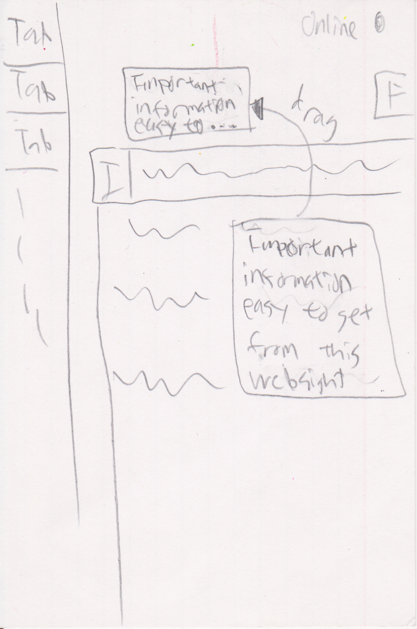
Design Sketches
Design 2 - A mobile note bubble app with sharing

Slide 8
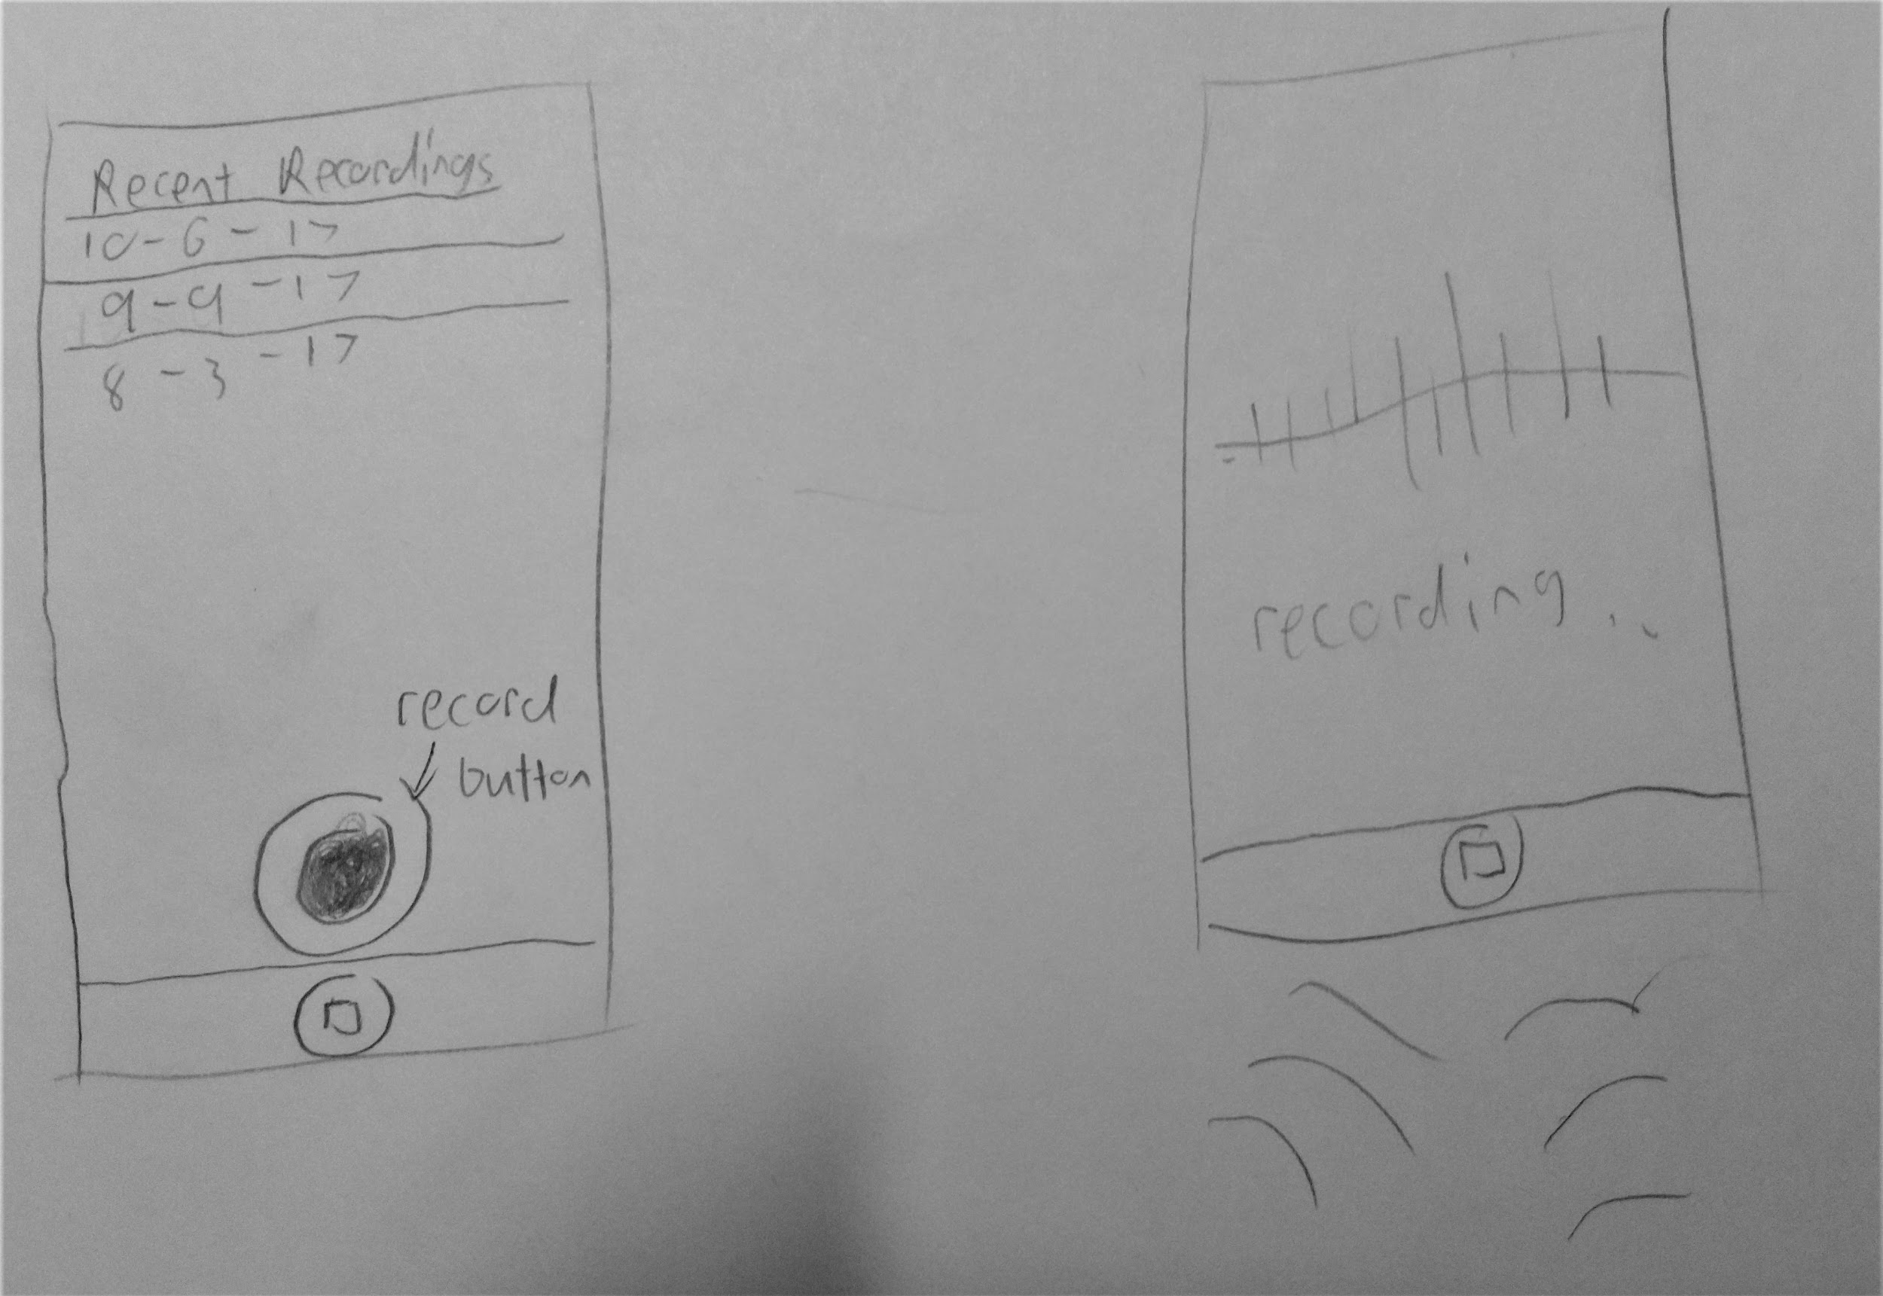
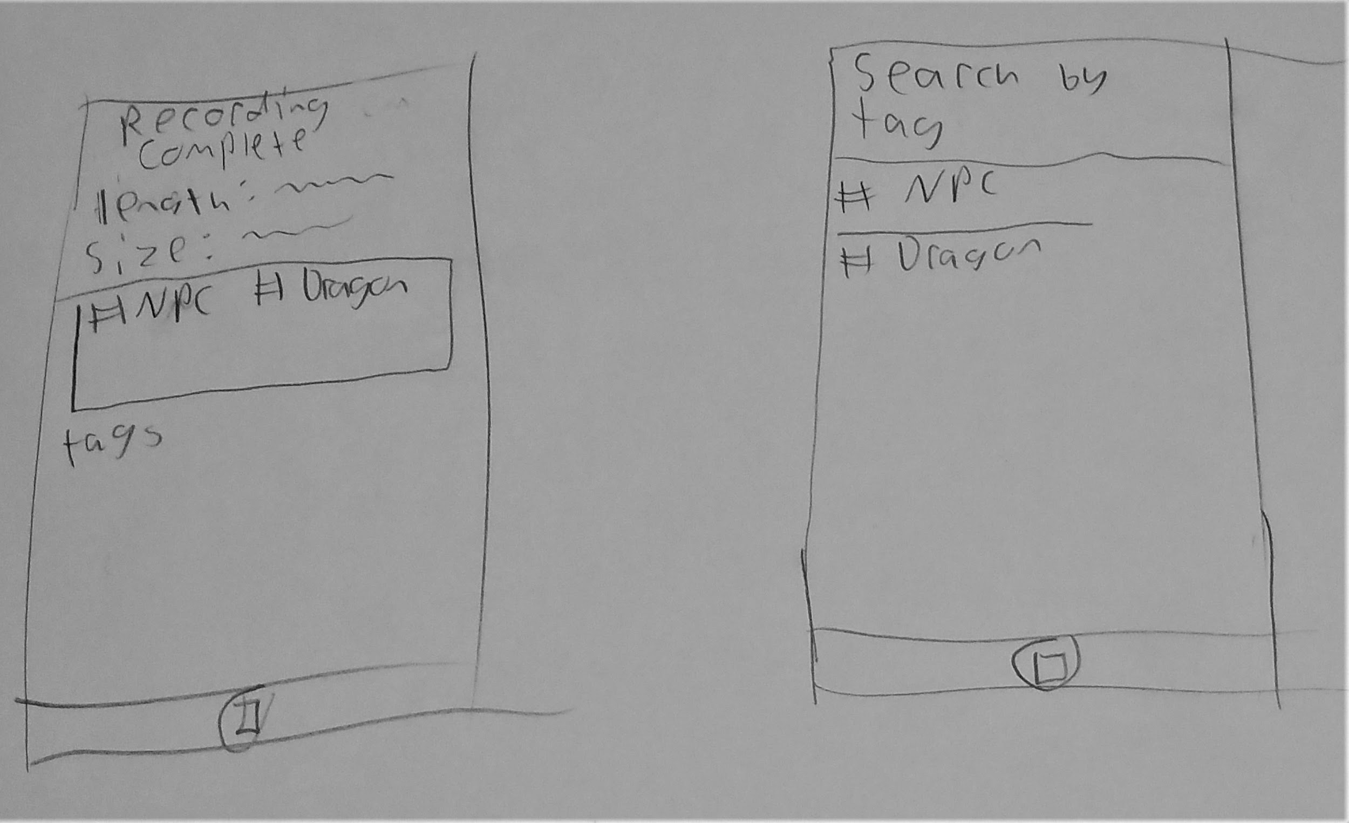
Design Sketches
Design 3: Mid-game Recording

Slide 9
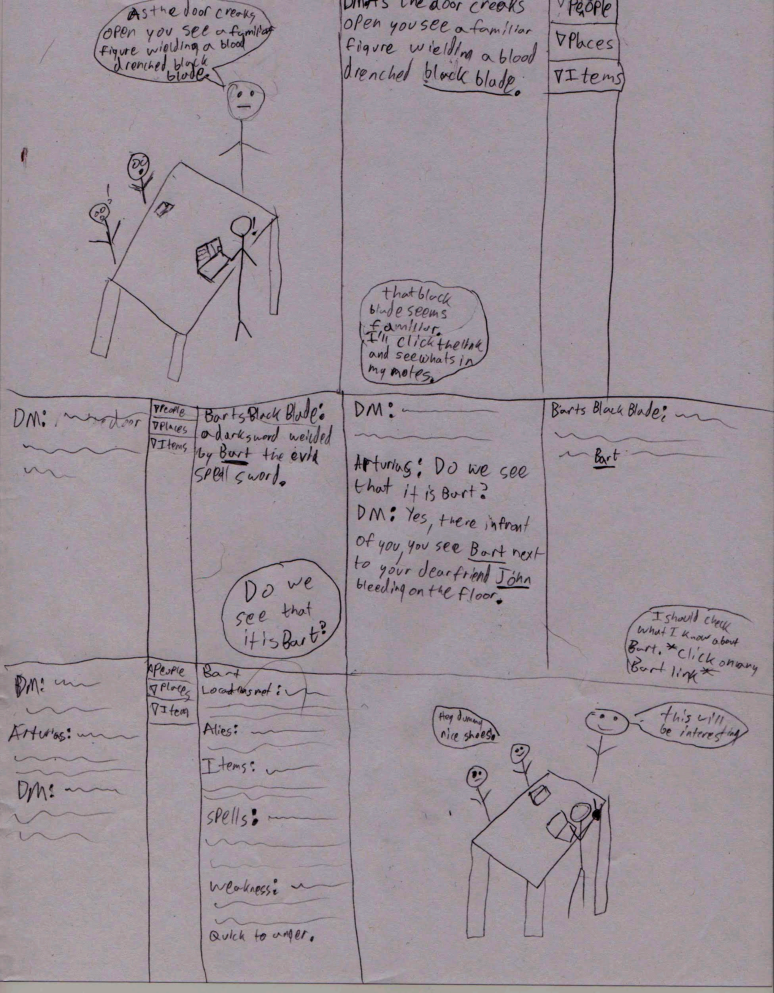
Storyboard:
Instantaneous voice to text translation.
Multiple users voices recognized for chat log.
Hyperlinking to related notes.
Detailed note sections

Slide 10
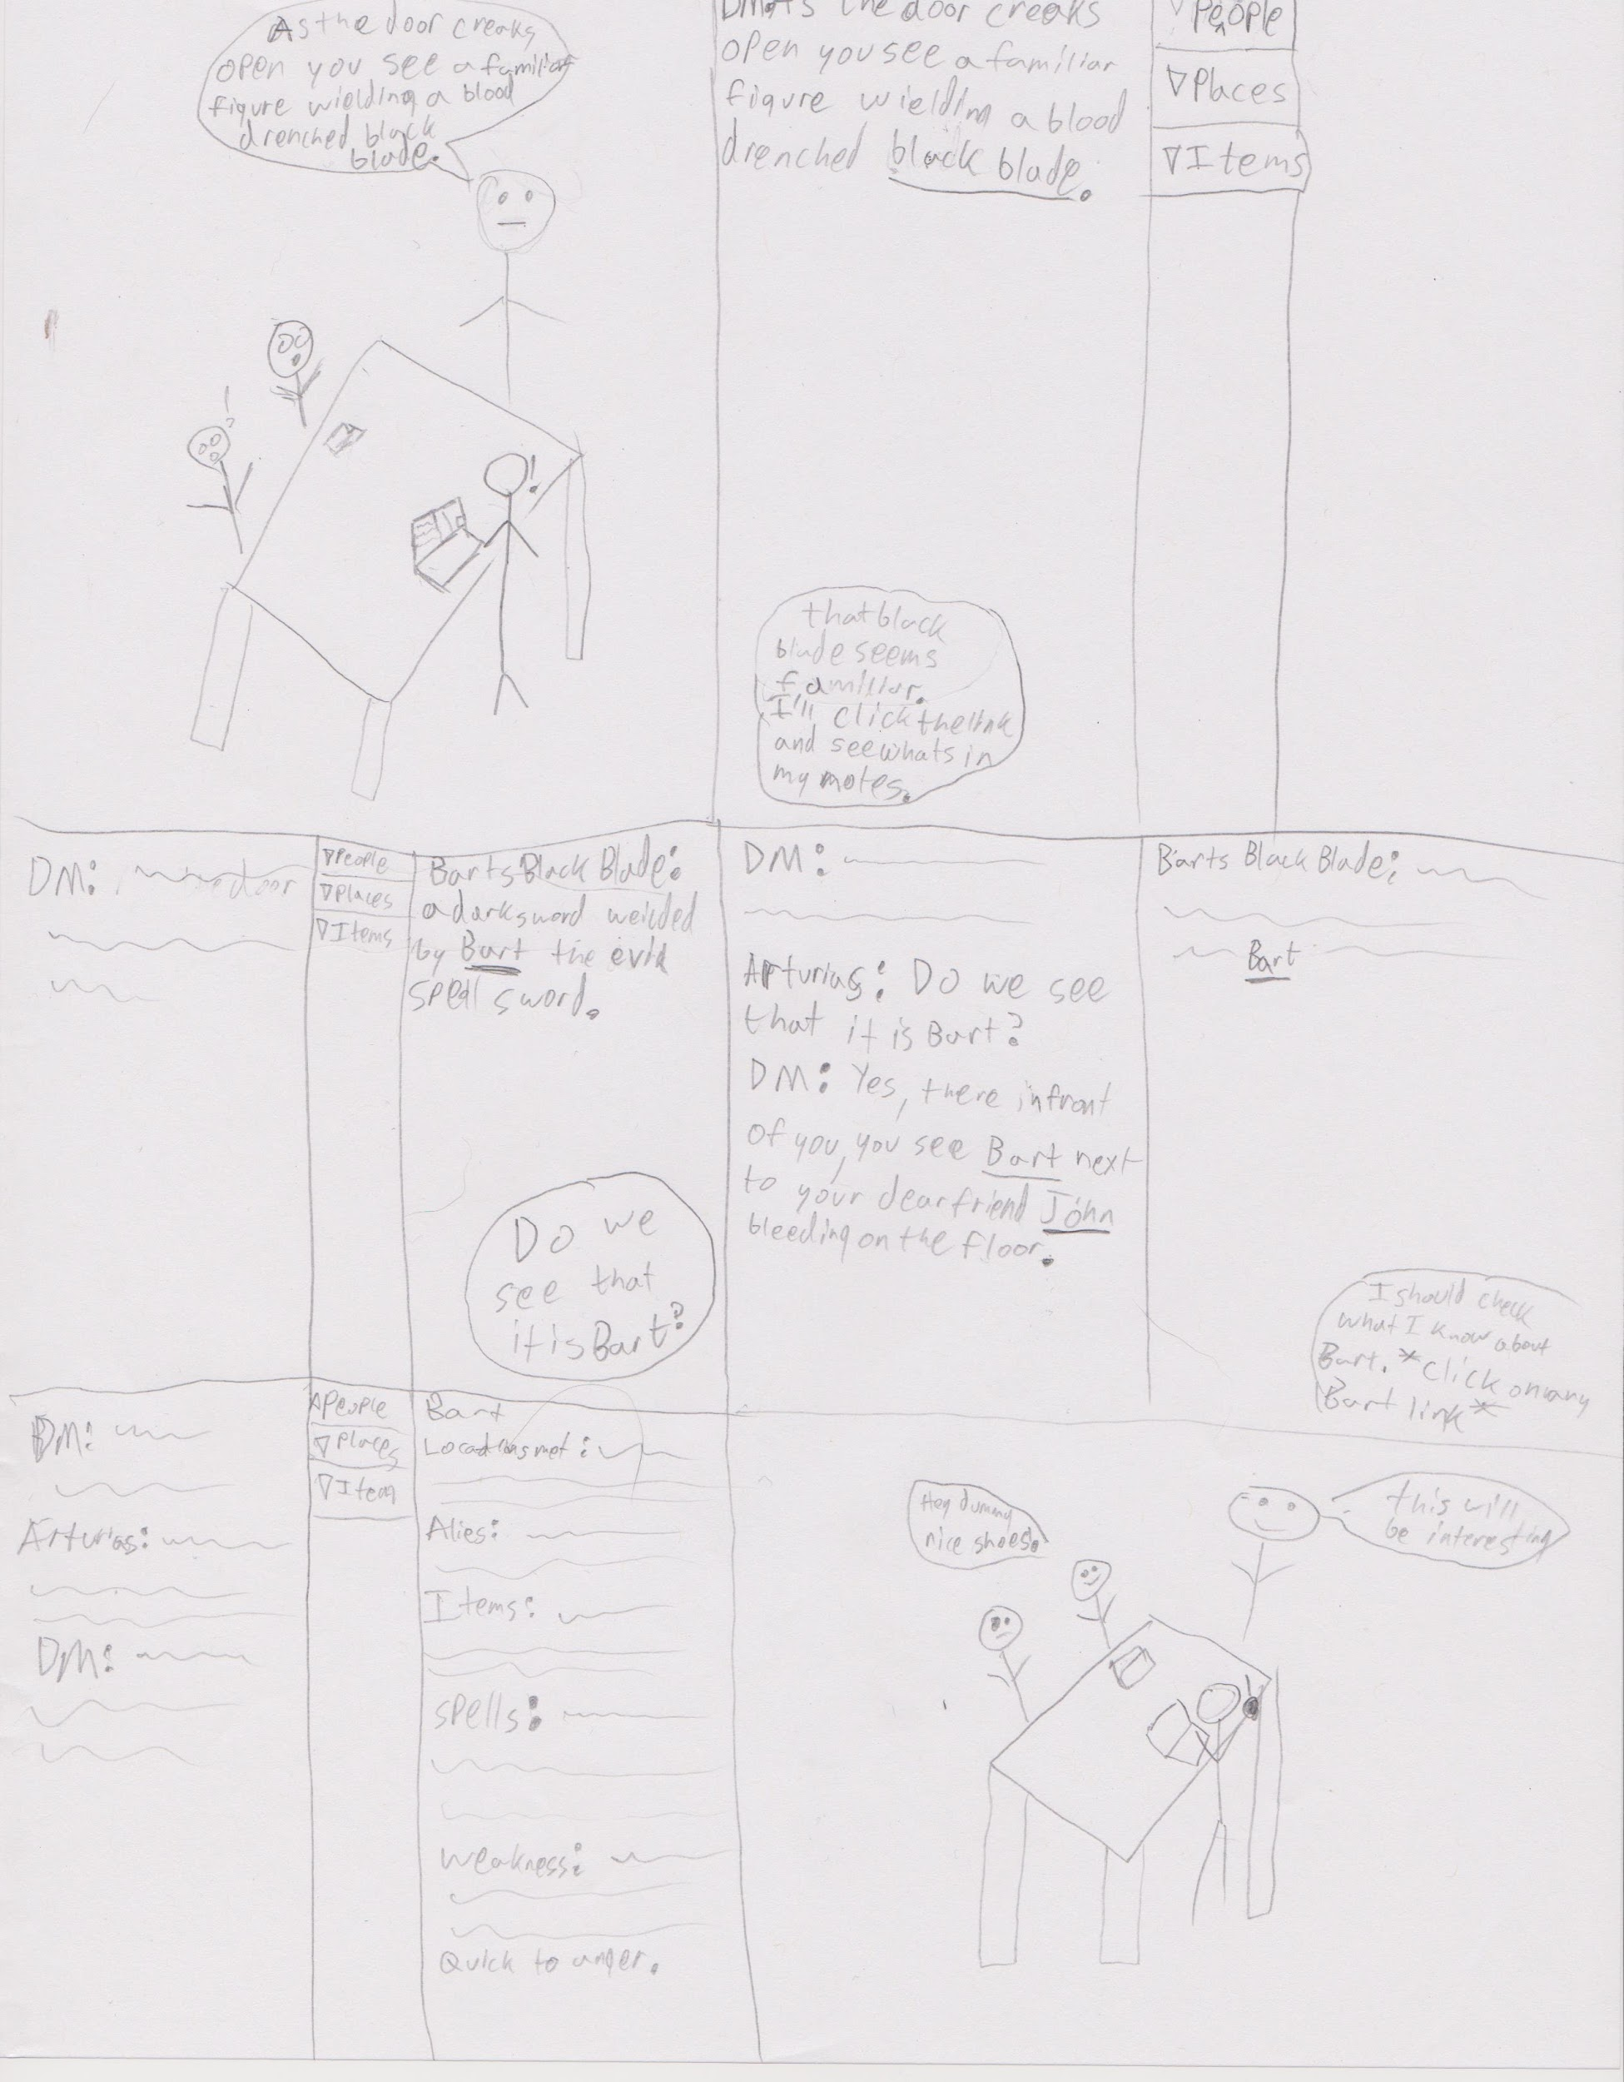
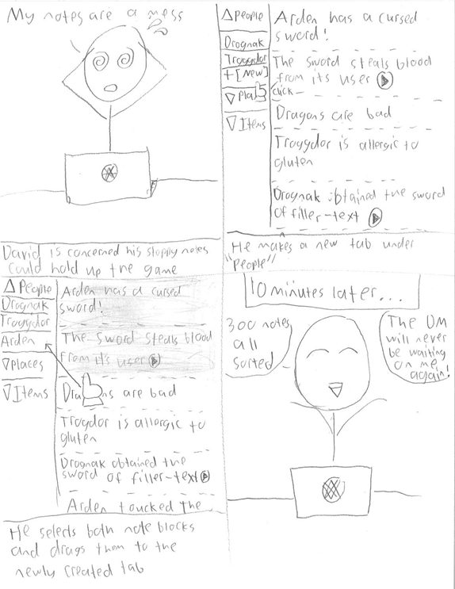
Storyboard:
Drag and drop notes.
Dropdown menus for quick navigation.
Creatable tabs.
Multiple selections possible.

Slide 11
Summary
We found that players need a quick way to take notes.
Our initial designs weren’t very specific to D&D
We have come up with a design that uses the best of all our designs and a few more innovations.

Slide 12
Questions

